Slide 1
Big Data Analytics
Metin Senturk

Slide 2
Outline
How to handle large datasets using:
Pandas
Use a database (SQLite, SQL Server, etc.)
Build your own multiprocessing reading to dataframe.
Use a 3rd party library for parallelism, such as Dask.

Slide 3
Using Pandas
Pandas is very good at handling datasets that can fit into RAM. However, there are ways to work with large datasets using a few options available in pandas API.
Options:
Chunking the data
Change dtypes of the columns
https://pandas.pydata.org/docs/user_guide/scale.html

Slide 4
Pandas - Chunking
pandas.read_csv(), offer parameters to control the chunksize when reading a single file.
It returns the file as dataframe. The only difference is it only returns # of rows specified in chunksize option.
Usage:
Assume that we are reading a file which has 10.2M rows. If chunksize is 500K, chunking will be like following.
Df_chunks will be an iterator.
To access each chunk, [df.shape for df in df_chunks]
df_chunks will have 21 df’s in it.
Each df.shape will have 500k rows, except the last one, which will have 200K rows.

Slide 5
Data Types
The default pandas data types are not the most memory efficient. This is especially true for text data columns with relatively few unique values (commonly referred to as “low-cardinality” data). By using more efficient data types, you can store larger datasets in memory.
'uint8' instead of 'int32' or 'int64'
'float32' instead of 'float64'
'category' instead 'object' for categorical data
https://www.dataquest.io/blog/pandas-big-data/

Slide 6
Using a Database
Use a database to store the data and create an index for the data.
https://pythonspeed.com/articles/indexing-pandas-sqlite/

Slide 7
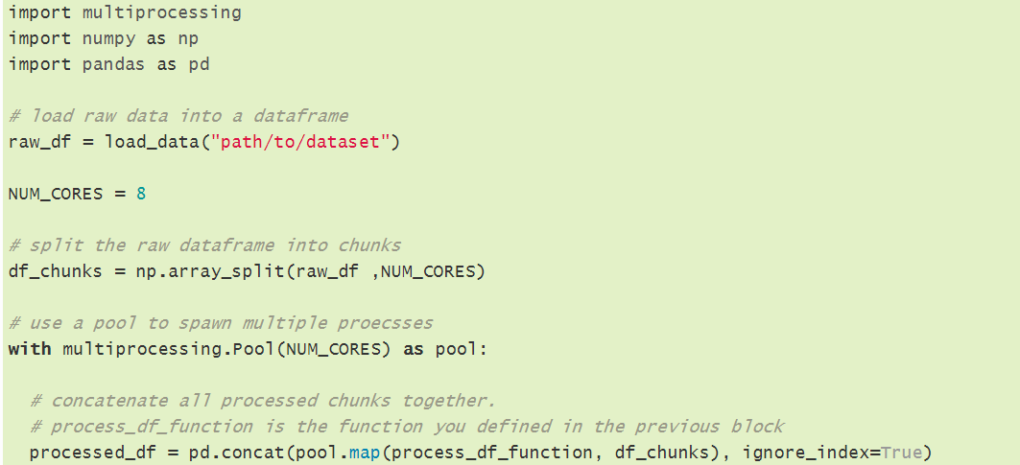
Building your Own Multiprocessing
Make a processing function for your df chunks and use standard multiprocessing to take advantage of multiprocessing.
Since your function will return the same shape of a dataframe, in the end, pd.concat will bring all results into one single dataframe.

Slide 8
Dask
Dask DataFrame is used in situations where Pandas is commonly needed, usually when Pandas fails due to data size or computation speed:
Manipulating large datasets, even when those datasets don’t fit in memory
Accelerating long computations by using many cores
Distributed computing on large datasets with standard Pandas operations like groupby, join, and time series computations
Dask DataFrame may not be the best choice in the following situations:
If your dataset fits comfortably into RAM on your laptop, then you may be better off just using Pandas. There may be simpler ways to improve performance than through parallelism

Slide 9
Persist into Distributed Memory
If you are on a cluster, then you may want to trigger a computation and store the results in distributed memory. In this case you do not want to call compute, which would create a single Pandas, NumPy, or list result. Instead, you want to call persist, which returns a new Dask object that points to actively computing, or already computed results spread around your cluster’s memory.
Most Dask workloads are lazy, that is, they don’t start any work until you explicitly trigger them with a call to compute().

Slide 10
Dask Limitations
Dask DataFrame does not implement the entire Pandas interface.
Operations that were slow on Pandas, like iterating through row-by-row, remain slow on Dask DataFrame.

Slide 11
More on Dasks
Find out more information at:
About Dask API: https://docs.dask.org/en/latest/dataframe-api.html
Not just pandas dataframes, but more: https://docs.dask.org/en/latest/user-interfaces.html

Slide 12
Thank You.
Questions, let me know.

